Slide 1
第六章 Instruction Pipeline
指令流水线
第一讲 流水线数据通路和控制逻辑
第二讲 流水线冒险处理
第三讲 高级流水线技术（自学）
Notes:
Start X:40流水线处理器中，指令重叠执行
流水线中，每条指令的执行被划分成相同多个阶段
每个流水段的执行时间相等，都在一个周期内完成
流水线中，多个指令可能同时需要用同一个部件
流水线中，转移指令或异常事件会破坏流水线的执行
流水线中，指令数据相关时也可能破坏流水线的执行

Slide 2
第一讲 流水线数据通路和控制
主 要 内 容
日常生活中的流水线处理例子：洗衣服
单周期处理器模型和流水线性能比较
什么样的指令集适合于流水线方式执行
如何设计流水线数据通路
  以MIPS指令子集来说明
如何设计流水线控制逻辑
  分析每条指令执行过程中的控制信号
  给出控制器设计过程
流水线冒险的概念

Slide 3
复习：A Single Cycle Processor
Branch
<31:26>
RegDst
Jump
Instruction<31:0>
op
Main
Control
ALUSrc
Instruction
Fetch Unit
:
Zero
<0:15>
<21:25>
<11:15>
Clk
<16:20>
ALUop
3
Rd
Rt
Rd
<5:0>
ALU
Control
RegDst
Imm16
1
Mux
0
func
Rs
Rt
3
RegWr
5
5
5
ALUctr
busA
MemWr
MemtoReg
Rw
Ra
Rb
Zero
busW
32
32 32-bit
Registers
ALU
0
32
busB
0
32
Clk
32
Mux
Mux
32
WrEn
Adr
1
1
Data In
32
imm16
Extender
Data
Memory
16
32
Instr<15:0>
Clk
ALUSrc
ExtOp
Notes:
I like to start today’s lecture with a look back at the single cycle processor.
The reason is that this single cycle processor has a lot of common with the pipeline processor we are going to talk about today.
Everything in this single cycle processor starts at the Instruction Fetch Unit which sends the Rs, Rt, Rd, and Immediate fields of the instruction to the datapath.
At the same time, the Opcode and Func fields of the instruction are sent to the Control Unit.
Based on the OP field of the instruction, the Main Control will set the control signals RegDst, ALUSrc, .... etc. properly.
The ALU Control then uses the ALUop from the Main control and the Func field of the instruction to generate the ALUctr signals to ask the ALU to do the right thing.
As far as the datapath is concerned, the data pretty much flow from left to right.
+1 = 1 min. (X:41)
Question: Why do we say that single cycle processor has more commonplaces with pipeline processor?

Slide 4
复习：Timing Diagram of a Load Instruction
Instruction Fetch
Instr Decode /
Address
Data Memory
Reg Wr
Reg. Fetch
Clk
Clk-to-Q
PC
Old Value
New Value
Instruction Memory Access Time
Rs, Rt, Rd,
Op, Func
Old Value
New Value
1
Delay through Control Logic
ALUctr
Old Value
New Value
ExtOp
Old Value
New Value
ALUSrc
Old Value
New Value
RegWr
Old Value
New Value
2
Register File Access Time
busA
Old Value
New Value
Register File Write Time
Delay through Extender & Mux
3
busB
Old Value
New Value
ALU Delay
Address
Old Value
New Value
Data Memory Access Time
busW
Old Value
New
Notes:
Well let’s take a look at the Load instruction’s timing diagram and see how we can break it up into smaller steps. The biggest contributors to the cycle time appears to be:
(1) Instruction Memory Access Time.
(2) Delay through the Control Logic, which happens in parallel with Register File Access.
(3) ALU Delay.
(4) Data Memory Access Time.
(5) And Register File Write Time.
Therefore, it makes sense to break up the Load instructions into these five steps:
(1) Instruction Fetch.
(2) Instruction Decode “slash” Register Fetch.
(3) Memory Address Calculation.
(4) Data Memory Access.
(5) And finally, Register File Write.
Notice that here I have used the term Register File Write time instead of Register File Write Setup time. The reason is that in a “real” register file, there is no such thing as set up time.
+2 = 13 min. (X:53)

Slide 5
Sequential Laundry（串行方式）
6 PM
7
8
9
10
11
Midnight
Time
30
40
20
30
40
20
30
40
20
30
40
20
T
a
s
k
O
r
d
e
r
A
B
C
D
串行方式下， 4 批衣服需要花费 6 小时（4x(30+40+20)=360分钟）
N批衣服，需花费的时间为Nx(30+40+20) = 90N
如果用流水线方式洗衣服，则花多少时间呢?

Slide 6
Pipelined Laundry: (Start work ASAP)
6 PM
7
8
9
10
11
Midnight
Time
30
40
40
40
40
20
T
a
s
k
O
r
d
e
r
串行为90分钟x4=6小时
N批则为90xN分钟
A
B
流水线方式下，需30+4x40+20
=210分 (3.5小时)
如果有N批衣服呢？
30+Nx40+20分钟
假定每一步时间均衡，则比串行方式提高约3倍！
C
D
流水方式下，所用时间主要与最长阶段的时间有关！

Slide 7
Redrawn Single-Cycle Datapath
Spring 2011 -- Lecture #20
rd
PC
instruction
memory
registers
rs
Data
memory
rt
ALU
+4
imm
2. Decode/
Register Read
1. Instruction
Fetch
5. Write
Back
3. Execute
4. Memory

Slide 8
Pipelined Datapath
Spring 2011 -- Lecture #20
rd
PC
instruction
memory
registers
rs
Data
memory
rt
ALU
+4
imm
2. Decode/
Register Read
1. Instruction
Fetch
5. Write
Back
3. Execute
4. Memory
Add registers between stages
  Hold information produced in previous cycle

Slide 9
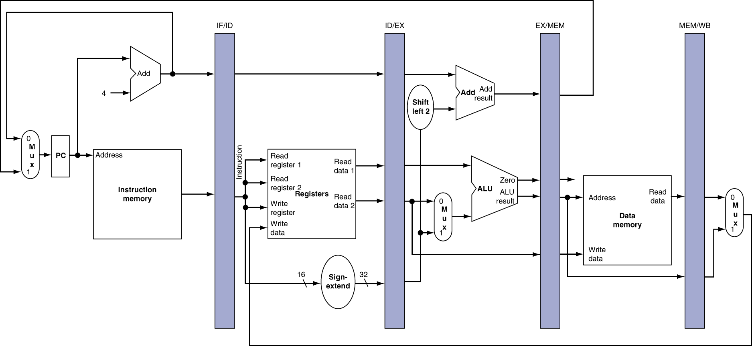
More Detailed Pipeline
lw $3,$2,5
add $6,$5,$4
sw $10,$9,30
beq $11,$12,30
sub $20,$21,$22
Notes:
Morgan Kaufmann Publishers
Chapter 4 — The Processor

Slide 10
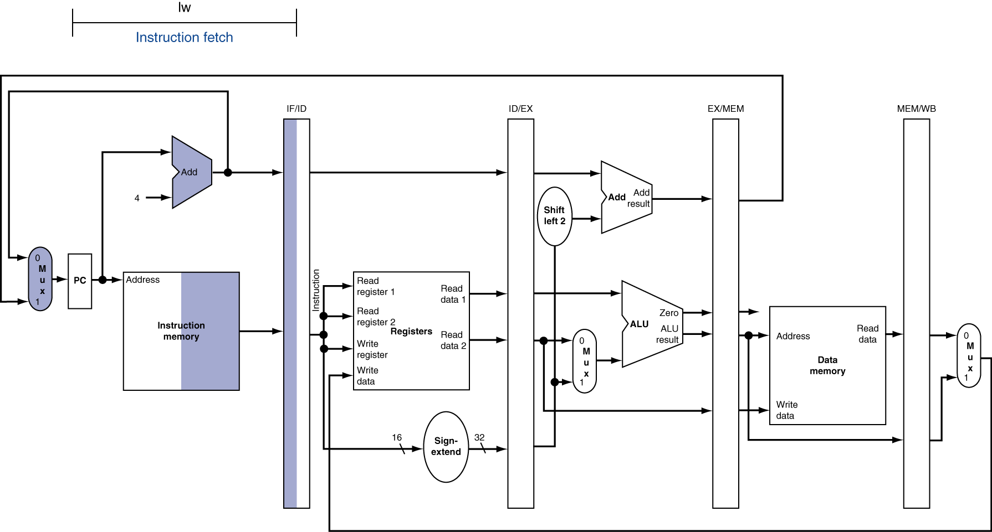
IF for Load, Store, …
lw $3,$2,5
add $6,$5,$4
sw $10,$9,30
beq $11,$12,30
sub $20,$21,$22
取指
Notes:
Morgan Kaufmann Publishers
Chapter 4 — The Processor

Slide 11
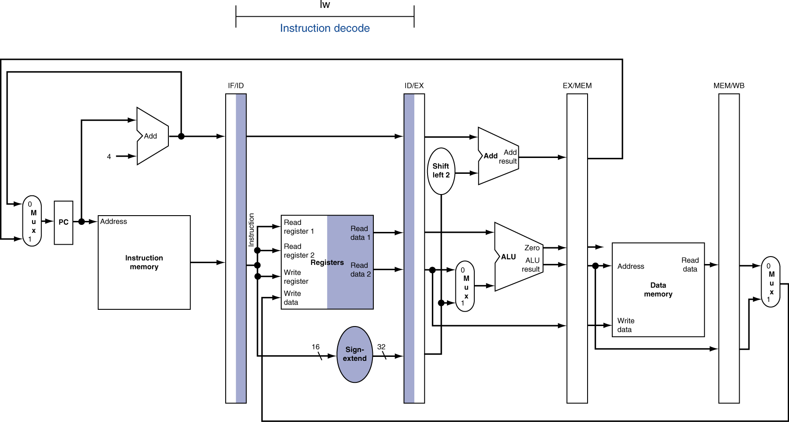
ID for Load, Store, …
lw $3,$2,5
add $6,$5,$4
sw $10,$9,30
beq $11,$12,30
sub $20,$21,$22
add
取指
译码
Notes:
Morgan Kaufmann Publishers
Chapter 4 — The Processor

Slide 12
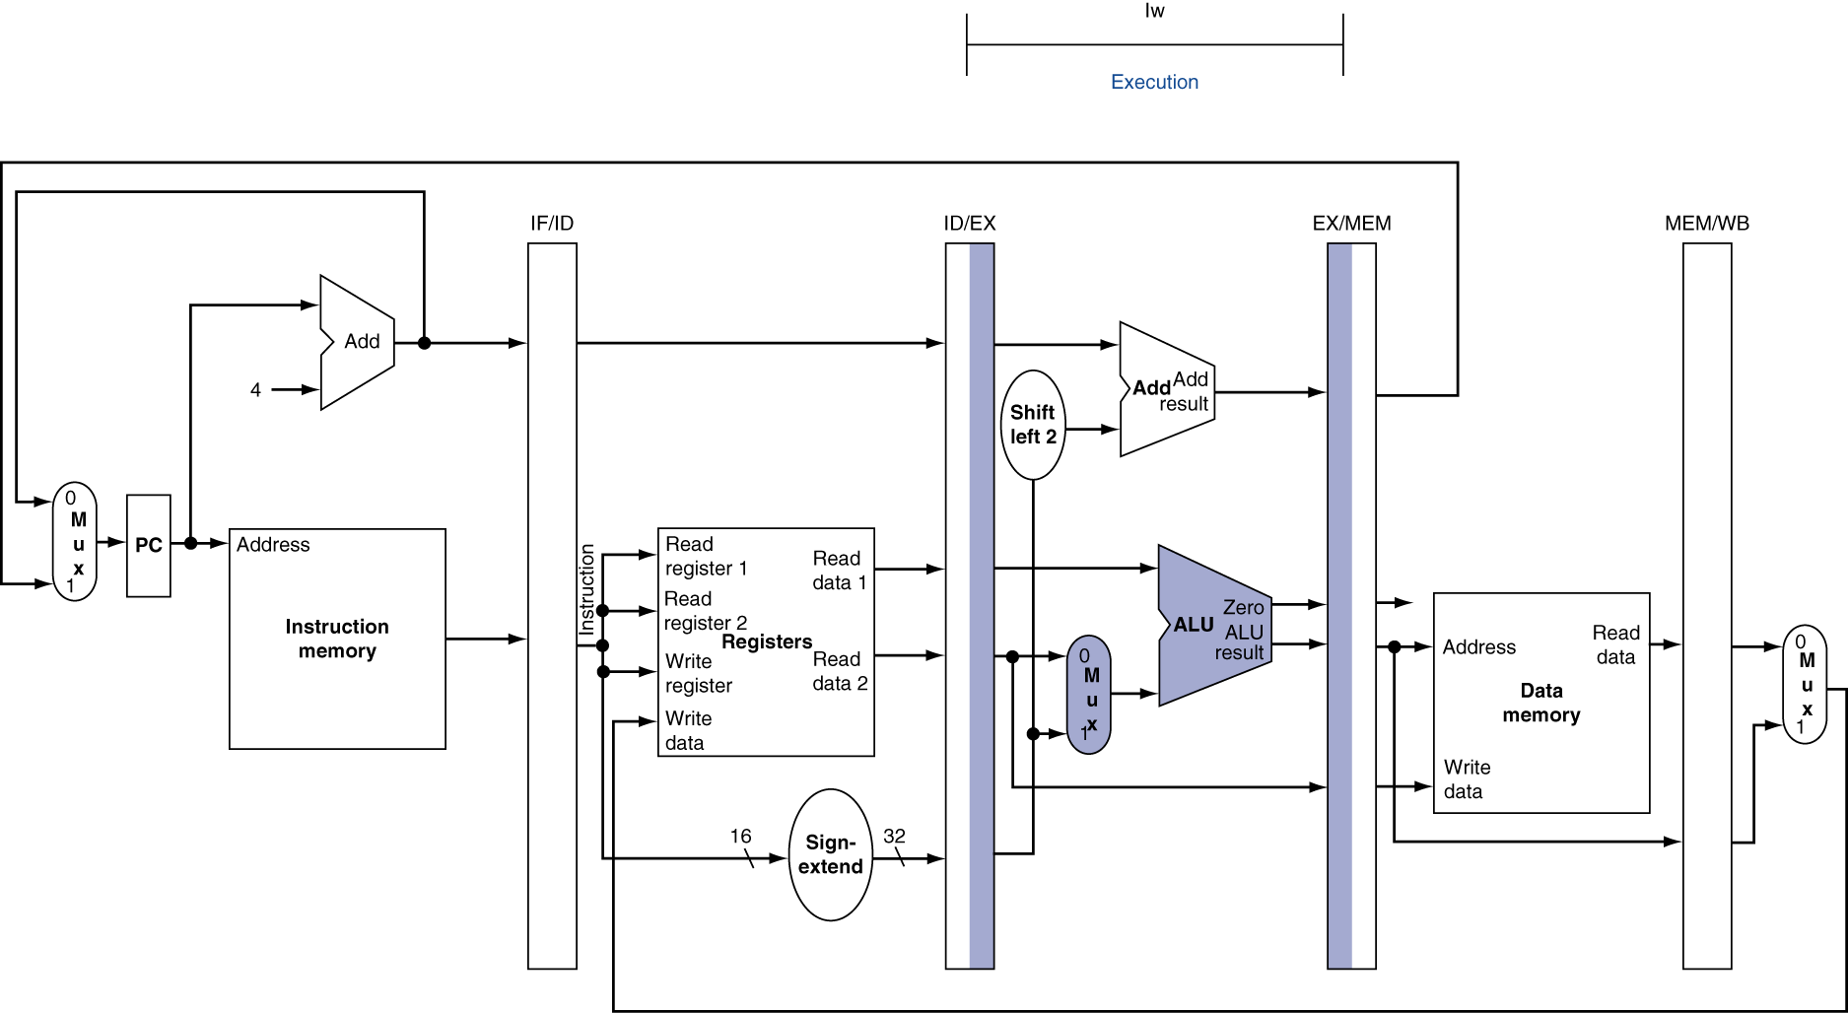
EX for Load
lw $3,$2,5
add $6,$5,$4
sw $10,$9,30
beq $11,$12,30
sub $20,$21,$22
sw
取指
add
译码
执行
Notes:
Morgan Kaufmann Publishers
Chapter 4 — The Processor

Slide 13
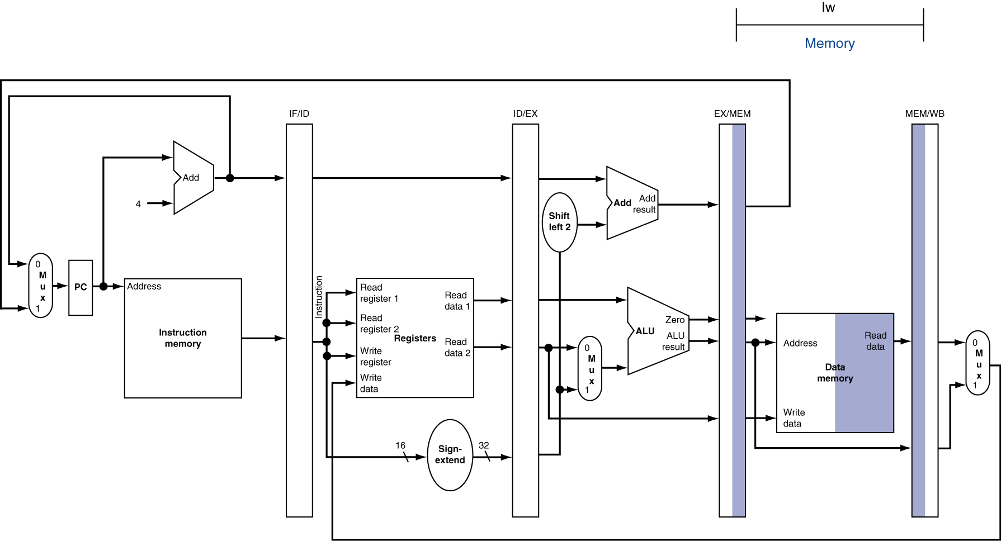
MEM for Load
lw $3,$2,5
add $6,$5,$4
sw $10,$9,30
beq $11,$12,30
sub $20,$21,$22
beq
取指
sw
译码
add
执行
访存
Notes:
Morgan Kaufmann Publishers
Chapter 4 — The Processor

Slide 14
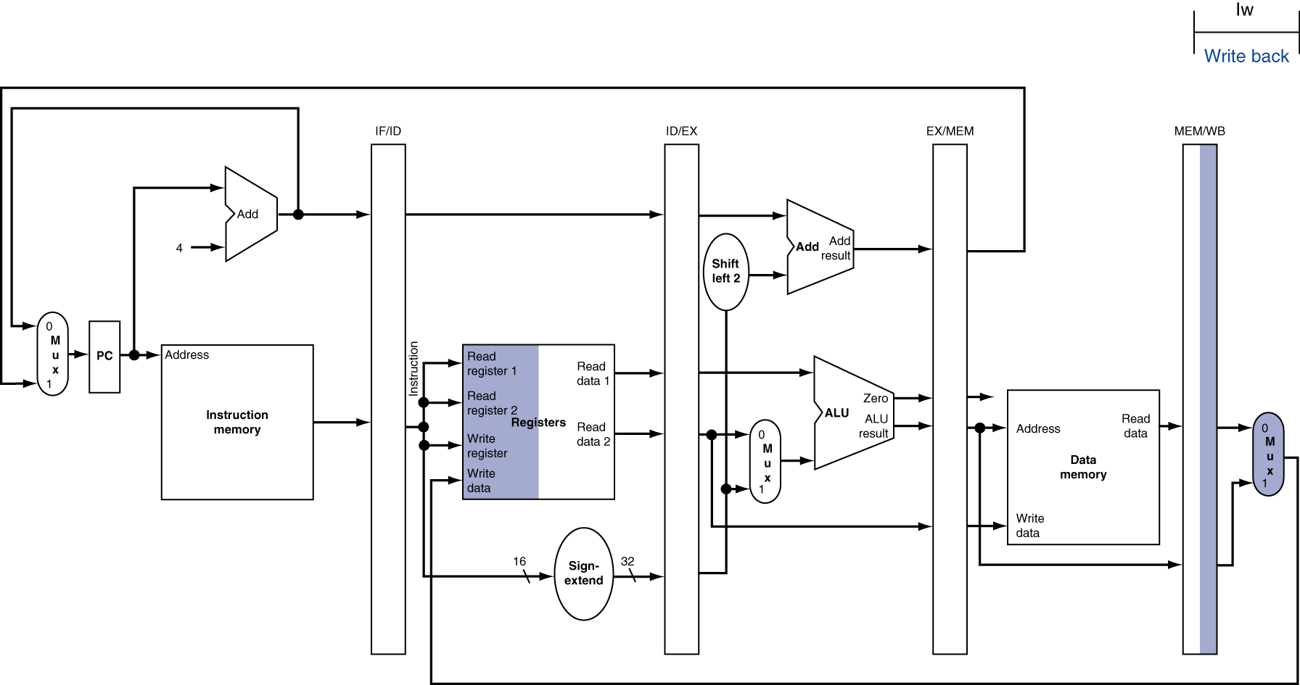
WB for Load
lw $3,$2,5
add $6,$5,$4
sw $10,$9,30
beq $11,$12,30
sub $20,$21,$22
sub
取指
beq
译码
sw
执行
add
访存
回写
Notes:
Morgan Kaufmann Publishers
Chapter 4 — The Processor

Slide 15
复习：Load指令的5个阶段
阶段1
阶段2
阶段 3
阶段 4
阶段5
Ifetch
Reg/Dec
Exec
Mem
Wr
Ifetch (取指) : 取指令并计算PC+4 (用到哪些部件？)
Reg/Dec (取数和译码) : 取数同时译码 (用到哪些部件？)
Exec (执行) : 计算内存单元地址 (用到哪些部件？)
Mem (读存储器) : 从数据存储器中读 (用到哪些部件？)
Wr(写寄存器): 将数据写到寄存器中 (用到哪些部件？)
  指令存储器、Adder
寄存器堆读口、指令译码器
这里寄存器堆的读口和写口可看成两个不同的部件。
扩展器、ALU
数据存储器
寄存器堆写口
Notes:
As shown here, each of these five steps will take one clock cycle to complete.
And in pipeline terminology, each step is referred to as one stage of the pipeline.
+1 = 8 min. (X:48)

Slide 16
单周期指令模型与流水模型的性能比较
假定以下每步操作所花时间为：
    取指：2ns
    寄存器读：1ns
    ALU操作：2ns
    存储器读：2ns
    寄存器写：1ns
单周期模型
  每条指令在一个时钟周期内完成
  时钟周期等于最长的lw指令的执行时间，即：8ns
  串行执行时，N条指令的执行时间为：8Nns
流水线性能
  时钟周期等于最长阶段所花时间为：2ns
  每条指令的执行时间为： 2nsx5=10ns
  N条指令的执行时间为：(4+N)x2ns
  在N很大时，比串行方式提高约 4 倍
  若各阶段操作均衡(例如，各阶段都是2ns)，则提高倍数为5倍。
Load指令执行时间总计为：8ns
(假定控制单元、PC访问、信号传递等没有延迟)
流水线方式下，单条指令执行时间不能缩短，但能大大提高指令吞吐率！

Slide 17
流水线指令集的设计
具有什么特征的指令集有利于流水线执行呢？
  长度尽量一致，有利于简化取指令和指令译码操作
    MIPS指令32位，下址计算方便: PC+4
    X86指令从1字节到17字节不等，使取指部件极其复杂
  格式少，且源寄存器位置相同，有利于在指令未知时就可取操作数
    MIPS指令的rs和rt位置一定，在指令译码时就可读rs和rt的值
    若位置随指令不同而不同，则需先确定指令类型才能取寄存器编号
  load / Store指令才能访问存储器，有利于减少操作步骤，规整流水线
    lw/sw指令的地址计算和运算指令的执行步骤规整在同一个周期
    X86运算类指令操作数可为内存数据，需计算地址、访存、执行
  内存中”对齐”存放，有利于减少访存次数和流水线的规整
  总之，规整、简单和一致等特性有利于指令的流水线执行
31
26
21
16
11
6
0
op
rs
rt
rd
shamt
func
6 bits
5 bits
5 bits
5 bits
5 bits
6 bits

Slide 18
Load指令的流水线
Cycle 1
Cycle 2
Cycle 3
Cycle 4
Cycle 5
Cycle 6
Cycle 7
Clock
1st lw
Ifetch
Reg/Dec
Exec
Mem
Wr
2nd lw
Ifetch
Reg/Dec
Exec
Mem
Wr
3rd lw
Ifetch
Reg/Dec
Exec
Mem
Wr
每个周期有五个功能部件同时在工作
后面指令在前面完成取指后马上开始
每个load指令仍然需要五个周期完成
但是，吞吐率(throughput)提高许多，理想情况下，有：
  每个周期有一条指令进入流水线
  每个周期都有一条指令完成
  每条指令的有效周期(CPI)为1
Notes:
For the load instructions, the five independent functional units in the pipeline datapath are:
(a) Instruction Memory for the Ifetch stage.
(b) Register File’s Read ports for the Reg/Decode stage.
(c) ALU for the Exec stage. (d) Data memory for the Mem stage.
(e) And finally Register File’s write port for the Write Back stage.
Notice that I have treated Register File’s read and write ports as separate functional units because the register file we have allows us to read and write at the same time.
Notice that as soon as the 1st load finishes its Ifetch stage, it no longer needs the Instruction Memory. Consequently, the 2nd load can start using the Instruction Memory (2nd Ifetch).
Furthermore, since each functional unit is only used ONCE per instruction, we will not have any conflict down the pipeline (Exec-Ifet, Mem-Exec, Wr-Mem) either.
I will show you the interaction between instructions in the pipelined datapath later. But for now, I want to point out the performance advantages of pipelining.
If these 3 load instructions are to be executed by the multiple cycle processor, it will take 15 cycles. But with pipelining, it only takes 7 cycles. This (7 cycles), however, is not the best way to look at the performance advantages of pipelining.
A better way to look at this is that we have one instruction enters the pipeline every cycle so we will have one instruction coming out of the pipeline (Wr stages) every cycle.
Consequently, the “effective” (or average) number of cycles per instruction is now ONE even though it takes a total of 5 cycles to complete each instruction.
+3 = 14 min. (X:54)

Slide 19
R-type指令的4个阶段
Cycle 1
Cycle 2
Cycle 3
Cycle 4
R-type
Ifetch
Reg/Dec
Exec
Wr
Ifetch: 取指令并计算PC+4
Reg/Dec: 从寄存器取数，同时指令在译码器进行译码
Exec: 在ALU中对操作数进行计算
Wr: ALU计算的结果写到寄存器
Notes:
Well, so far so good. Let’s take a look at the R-type instructions.
The R-type instruction does NOT access data memory so it only takes four clock cycles, or in our new pipeline terminology, four stages to complete.
The Ifetch and Reg/Dec stages are identical to the Load instructions. Well they have to be because at this point, we do not know we have a R-type instruction yet.
Instead of calculating the effective address during the Exec stage, the R-type instruction will use the ALU to operate on the register operands.
The result of this ALU operation is written back to the register file during the Wr back stage.
+1 = 15 min. (55)

Slide 20
含R-type和 Load 指令的流水线
Cycle 1
Cycle 2
Cycle 3
Cycle 4
Cycle 5
Cycle 6
Cycle 7
Cycle 8
Cycle 9
Clock
R-type
Ifetch
Reg/Dec
Exec
Wr
Ops! We have a problem!
R-type
Ifetch
Reg/Dec
Exec
Wr
Load
Ifetch
Reg/Dec
Exec
Mem
Wr
R-type
Ifetch
Reg/Dec
Exec
Wr
R-type
Ifetch
Reg/Dec
Exec
Wr
上述流水线有个问题: 两条指令试图同时写寄存器，因为
  Load在第5阶段用寄存器写口
  R-type在第4 阶段用寄存器写口
把一个功能部件同时被多条指令使用的现象称为结构冒险(Struture Hazard)
为了流水线能顺利工作，规定：
  每个功能部件每条指令只能用一次（如：写口不能用两次或以上）
  每个功能部件必须在相同的阶段被使用（如：写口总是在第五阶段被使用）
或称为资源冲突！
Notes:
What happened if we try to pipeline the R-type instructions with the Load instructions?
Well, we have a problem here!!!
We end up having two instructions trying to write to the register file at the same time!
Why do we have this problem (the write “bubble”)?
Well, the reason for this problem is that there is something I forget to tell you.
+1 = 16 min. (X:56)

Slide 21
R-type的Wr操作延后一个周期执行
NOOP!
1
2
3
4
5
R-type
Ifetch
Reg/Dec
Exec
Mem
Wr
加一个NOP阶段以延迟“写”操作:
  把“写”操作安排在第5阶段, 这样使R-Type的Mem阶段为空NOP
Clock
Cycle 1
Cycle 2
Cycle 3
Cycle 4
Cycle 5
Cycle 6
Cycle 7
Cycle 8
Cycle 9
R-type
Ifetch
Reg/Dec
Exec
Mem
Wr
R-type
Ifetch
Reg/Dec
Exec
Mem
Wr
Load
Ifetch
Reg/Dec
Exec
Mem
Wr
R-type
Ifetch
Reg/Dec
Exec
Mem
Wr
R-type
Ifetch
Reg/Dec
Exec
Mem
Wr
这样使流水线中的每条指令都有相同多个阶段!
Notes:
Well one thing we can do is to add a “Nop” stage to the R-type instruction pipeline to delay its register file write by one cycle.
Now the R-type instruction ALSO uses the register file’s witer port at its 5th stage so we eliminate the write conflict with the load instruction.
This is a much simpler solution as far as the control logic is concerned. As far as performance is concerned, we also gets back to having one instruction completes per cycle.
This is kind of like promoting socialism: by making each individual R-type instruction takes 5 cycles instead of 4 cycles to finish, our overall performance is actually better off.
The reason for this higher performance is that we end up having a more efficient pipeline.
+1 = 20 min. (Y:00)

Slide 22
Store指令的四个阶段
Cycle 1
Cycle 2
Cycle 3
Cycle 4
NOOP!
Store
Ifetch
Reg/Dec
Exec
Mem
Wr
Ifetch：取指令并计算PC+4
Reg/Dec： 从寄存器取数，同时指令在译码器进行译码
Exec：16位立即数符号扩展后与寄存器值相加，计算主存地址
Mem：将寄存器读出的数据写到主存
Wr: 加一个空的写阶段，使流水线更规整！
Notes:
Let’s continue our lecture by looking at the store instruction.
Once again, the Ifetch and Reg/Decode stages are the same as all other instructions.
The Exec stage of the store instruction calculates the memory address.
Once the address is calculated, the store instruction will write the data it read from the register file back at the Reg/Decode stage into the data memory during the Mem stage.
Notice that unlike the load instruction which takes five cycles to accomplish its task, the Store instruction only takes four cycles or four pipe stages.
In order to keep our pipeline diagram looks more uniform, however, we will keep the Wr stage for the store instruction in the pipeline diagram.
But keep in mind that as far as the pipelined control and pipelined datapath are concerned, the store instruction requires NOTHING to be done once it finishes its Mem stage.
+2 = 27 min. (Y:07)

Slide 23
Beq的四个阶段
Cycle 1
Cycle 2
Cycle 3
Cycle 4
NOOP!
Beq
Ifetch
Reg/Dec
Exec
Mem
Wr
与多周期通路有什么不同？
Ifetch: 取指令并计算PC+4
Reg/Dec:从寄存器取数，同时指令在译码器进行译码
Exec: 执行阶段
  ALU中比较两个寄存器的大小（做减法）
  Adder中计算转移地址
Mem: 如果比较相等, 则：
  转移目标地址写到PC
为什么流水线中不进行“投机”计算？
Wr: 加一个空写阶段，使流水线更规整！
Notes:
Well similar to the store instruction, the branch instruction only consists of four pipe stages.
Ifetch and Reg/decode are the same as all other instructions because we do not know what instruction we have at this point. We have not finish decoding the instruction yet.
During the Execute stage of the pipeline, the BEQ instruction will use the ALU to compare the two register operands it fetched during the Reg/Dec stage.
At the same time, a separate adder is used to calculate the branch target address.
This is difference from M-cycle processor where target address is calculated by ALU but at the 2nd cycle.
If the registers we compared during the Execute stage (point to the last bullet) have the same value, the branch is taken.
That is, the branch target address we calculated earlier (last bullet) will be written into the Program Counter.
Once again, similar to the Store instruction, the BEQ instruction will require NEITHER the pipelined control nor the pipelined datapath to do ANY thing once it finishes its Mem stage.
With all these talk about pipelined datapath and pipelined control, let’s take a look at how the pipelined datapath looks like.
+2 = 29 min. (Y:09)

Slide 24
A Pipelined Datapath（五阶段流水线数据通路）
Clock-to-Q delay
不包含控制逻辑
Clk
Ifetch (IF)
Reg/Dec (ID)
Exec (Ex)
Mem
Wr
有！寄存器写口
RegWr
ExtOp
ALUOp
Branch
1
0
Wr阶段没有DataPath吗？
PC+4
PC+4
PC
PC+4
Imm
Imm
Rs
busA
Zero
Data
Mem
A
Ra
busB
IUnit
Rb
Exec
Unit
RA
Do
IF/ID Register
Ex/Mem Register
Mem/Wr Register
Rt
ID/Ex Register
1
RFile
WA
Mux
Rw
Di
Di
Rt
0
0
I
Rd
1
为什么需要这些Reg？
保存每个周期执行的结果!
属于内部寄存器，对程序员透明，不需作为现场保存
RegDst
ALUSrc
MemWr
MemtoReg
下面看每条指令在流水线通路中的执行过程
Notes:
The pipelined datapath consists of combination logic blocks separated by pipeline registers. If you get rid of all these registers (not the PC), this pipelined datapath is reduced to the single-cycle datapath.
This should give you extra incentive to do a good job on your single cycle processor design homework because you can build your pipeline design based on your single cycle design.
Anyway, the registers mark the beginning and the end of a pipe stage.
In the multiple clock cycle lecture, I recommended that the best way to think about a logic clock cycle is that it begins slightly after the clock tick and ends right at the next clock tick.
For example here, the Reg/Decode stage begins slightly after this clock tick when the output of the IF/ID register has stabilized to its new value AND ends RIGHT at the next clock tick when the output of the register file is clocked into the ID/Exec register.
At the end of the Reg/Decode stage, the register output that just clocked into the ID/Exec register has NOT yet propagate to the register output yet. It takes a Clk-to-Q delay.
When the new value we just clocked in (points to the clock tick) has propagate to the register output, then we have reach the beginning of the Exec stage.
Notice that the Wr stage of the pipeline starts here (last cycle) but there is no corresponding datapath underneath it because the Wr stage of the pipeline is handled by the same part of the pipeline that handles the Register Read stage.
This part of the datapath (Reg File) is the only part that is used by more than one stage of the pipeline. This is OK because the register file has independent Read and Write ports.
More specifically, the Reg/Decode stage of the pipeline uses the register file’s read port while the Write Back stage of the pipeline uses the register file’s write port.
+3 = 32 min. (Y:12)

Slide 25
取指令（Ifetch) 阶段
第10H单元指令: lw $1, 0x100($2) 功能：$1 <- Mem [($2) + 0x100]
You are here!
Clk
Ifetch
Reg/Dec
Exec
Mem
RegWr
ExtOp
ALUOp
Branch
1
0
PC+4
PC+4
PC+4
Imm
Imm
PC = 14
Rs
busA
Zero
Data
Mem
A
Ra
busB
IF/ID: lw $1, 100 ($2)
Exec
Unit
RA
Do
IUnit
Rb
Ex/Mem Register
Mem/Wr Register
Rt
ID/Ex Register
1
RFile
WA
Mux
Rw
Di
Di
I
Rt
0
0
Rd
1
下一目标：设计IUnit（功能是啥？）
RegDst
ALUSrc
MemWr
MemtoReg
先猜一下IUnit中有哪些功能部件？
Notes:
Let’s follow a Load instruction down the pipeline and see how everything works.
Every instruction starts at the Instruction Fetch stage which:
(a) Begins slightly after the first clock tick when PC output has stabilized to its new value.
(b) And ends when the output of the I-Unit is clocked into the IF/ID register.
This picture shows the state of the pipeline at the end of the Ifetch stage (you are here).
Let’s expand this part of the datapath and take a better look.
+1 = 33 min. (Y:13)

Slide 26
指令部件 IUnit的设计
第10H单元指令: : lw $1, 0x100($2) 随后的指令在14H号单元中！
指令部件功能
You are here!
Instr <- Mem[PC]
PC<- PC+4
Clk
Ifetch
Reg/Dec
开始从14H号单元取指！
1
0
这里MUX的控制信号由其他阶段产生！
“4”
流水段寄存器用来存放各阶段的执行结果
总是在下个时钟到来后的Clock-to-Q输出
Adder
PC = 14
10
IF/ID: lw $1, 100 ($2)
Address
PC 新值（14H） ≠旧输出（10H）
Instruction
Memory
应把哪些信息存到流水段寄存器IF/ID中？
Instruction
应保存后面阶段用到的指令和PC+4的值！
取指阶段有哪些控制信号？
不需控制信号，因为每条指令执行功能一样，是确定的，无需根据指令的不同来控制执行不同的操作！
指令在随后阶段被送出译码！
PC+4用来计算转移目标地址
Notes:
Let’s assume the Load instruction we are following is in memory location TEN, 10.
So the Ifetch stage begins shortly after the first clock tick when the value 10 appears on the Program Counter register output.
This is used as the address to access the Instruction Memory and at the same time it is fed to the adder so it can be increment by four.
At the end of the Ifetch stage, this clock tick will clock the output of the instruction memory, which is the Load instruction, into the If/ID pipeline register.
As the same time, the PC plus 4 value, that is 14 in this case, will be clocked into the PC.
Notice that the picture here shows the stage of the pipeline at the END of the Ifetch stage (you are here) so the number 14, even though is already latched into the register, will not appear at the PC output until Clk-to-Q time later.
Similarly, the load instruction we just clocked into the IF/ID register will NOT appear at the register output until a Clk-toQ delay after this clock.
And when it appears at the IF/iD register output, we will be in the Reg/Decode stage.
+2 = 35 min. (Y:15)

Slide 27
译码/取数（Reg/Dec）阶段
Location 10H: lw $1, 0x100($2) 功能：$1 <- Mem[($2) + 0x100]
You are here!
Clk
Ifetch
Reg/Dec
Exec
Mem
RegWr
ExtOp
ALUOp
Branch
1
RegWr是Wr段的信号
0
PC+4
PC+4
PC
PC+4
IF/ID:
Imm
Imm
Rs
busA
Zero
Data
Mem
A
Ra
busB
ID/Ex: Reg. 2 & 0x100
IUnit
Rb
Exec
Unit
RA
Do
Ex/Mem Register
Mem/Wr Register
指令还要存ID/EX中吗？
不要，只要存相关信息
Rt
1
RFile
WA
Mux
Rt
Rw
Di
Di
I
0
0
Rd
1
Reg[Rs],Reg[Rt],Rt,Rd,Imm16,PC+4等被保存在ID/EXE中
RegDst
ALUSrc
MemWr
MemtoReg
该阶段有哪些控制信号？
没有！因是所有指令的公共操作，故无控制信号！
Notes:
This picture shows the state of the pipeline at the end of Load’s Reg/Decode stage.
All the datapath has to do is read register (Ra and busA) R2 from the register file.
As the same time, we need to pass the Immediate field of the instruction onto the next stage (ID/Exec) register because the immediate field is needed for address calculation.
Let’s concentrate on the load instruction (point to the 1st bullet) going down the pipe and ignore what is in the PC and IF/ID registers for now.
Since we are here (Your are Here), Register R2 and Imm16 have already clocked into ID/Exec register but they have not yet appeared at the register’s output.
+1 = 36 min. (Y:16)

Slide 28
Load指令的地址计算阶段
Location 10H: lw $1, 0x100($2) 功能：$1 <- Mem[($2) + 0x100]
指令已被译码，可确定执行部件的控制信号！
You are here!
Clk
Ifetch
Reg/Dec
Exec
Mem
ALUOp=？
RegWr
ExtOp=？
Branch
1
0
PC+4
PC+4
PC
PC+4
IF/ID:
Imm
Imm
Rs
busA
Zero
Data
Mem
A
Ra
busB
Rb
Exec
Unit
RA
IUnit
Ex/Mem: Load’s Address
Do
ID/Ex Register
Mem/Wr Register
Rt
1
RFile
WA
Mux
Rt
Rw
Di
Di
I
0
0
Rd
1
目的寄存器Rt不传递下去会怎样？
连接到错误的目的地址，指令执行错误！
RegDst=0
ALUSrc=？
MemWr
MemtoReg
下一目标：设计执行部件(Exec Unit)
猜有哪些部件？
Notes:
If we wait a little bit longer (beginning of Exe), Register R2 and Imm16 will appear at the ID/Exec register output and we are now in the Exec stage where we will calculate the Memory Address for the load instruction.
Notice that besides calculating the Load’s Memory Address, we also need to pass the Rt field (RegDst = 0) of the instruction down the pipeline.
The reason is that we will need to use Rt field later on to specify which register to write to when we reach the end of the Load pipeline.
Also notice that this is the first stage of the pipeline that requires any control signals.
We will talk more about this (Rt field and other control signals) later but for now, let’s expand this part of the datapath and take a closer look at what is going on.
+2 = 38 min. (Y:18)

Slide 29
执行部件（Exec Unit）的设计
执行部件功能？
计算内存地址
计算转移目标地址
一般ALU运算
You are here!
Clk
Exec
Mem
Adder用于计算分支指令的转移地址
Load指令的各控制信号取值？
<< 2
Target
RegDes=0, ALUSrc=1 ALUop=addu, Extop=1
Adder
32
PC+4
Store指令呢？
busA
32
ID/Ex Register
32
Zero
RegDes=x, ALUSrc=1 ALUop=addu, Extop=1
Ex/Mem: Load’s Memory Address
busB
ALU
ALUout
0
32
Branch指令呢？
32
Mux
RegDes=x, ALUSrc=0 ALUop=subu, Extop=1
imm
3
ALUctr
Extender
1
16
32
ALU
Ori指令呢？
Control
func
6
ExtOp=?
ALUSrc=?
3
RegDes=0, ALUSrc=1 ALUop=or, Extop=0
ALUOp=?
R型指令呢？
RegDes=1, ALUSrc=0 ALUop=‘func’, Extop=x
Notes:
At the beginning of the Exec cycle, ID/Exec register’s output will be stabilized to Register R2 (bus A) and Imm16.
By setting the control signals ExtOp and ALUSrc to 1s, the 16-bit immediate field will be sign extended to 32 bits and pass onto the ALU.
The ALU then add (ALUOp = Add) this sign extended version of the Immediate field to Register 2 (busA) to form the memory address.
By the end of the Exec cycle (you are here), the ALU output will be valid and will be stored into the Exec/Mem pipeline register.
This Memory Address (Exec/Mem) will appear at the output of the Exec/Mem register a Clk-to-Q time after this clock tick (you are here).
+1 = 39 min. (Y:19)

Slide 30
Load指令的存储器读(Mem)周期
Location 10H: lw $1, 0x100($2) 功能： $1 <- Mem[($2) + 0x100]
You are here!
Clk
Ifetch
Reg/Dec
Exec
Mem
RegWr
ExtOp
ALUOp
Branch=0
1
0
PC+4
PC+4
PC
PC+4
IF/ID:
Imm
Imm
Rs
busA
Zero
Data
Mem
A
Ra
busB
Rb
Exec
Unit
RA
Do
IUnit
ID/Ex Register
Ex/Mem Register
Mem/Wr: Load’s Data
Rt
1
RFile
WA
Mux
Rw
Di
Di
Rt
0
0
I
Rd
1
RegDst
ALUSrc
MemWr=0
MemtoReg
该阶段有反向数据流，可能会引起冒险！以后介绍。
Notes:
And it will be used to read the Data Memory (RA).
By setting the clock cycle time longer than the data memory read access time, we can guarantee the memory output (Do) will be stable by the end of the Mem cycle (you are here).
And this clock tick will trigger the Mem/Wr register to latch in Load’s data.
We have to pass the Load instruction’s Rt field down the pipeline one more time because we still have not use it yet.
+1 = 40 min. (Y:20)

Slide 31
Load指令的回写（Write Back）阶段
Location 10H: lw $1, 0x100($2) 功能：$1 <- Mem[($2) + 0x100]
Clk
Ifetch
Reg/Dec
Exec
Mem
Wr
RegWr=1
ExtOp
ALUOp
Branch
1
0
PC+4
PC+4
PC
PC+4
IF/ID:
Imm
Imm
Rs
busA
Zero
Data
Mem
A
Ra
busB
IUnit
Rb
Exec
Unit
RA
Do
ID/Ex Register
Ex/Mem Register
Mem/Wr Register
Rt
1
RFile
WA
Mux
Rw
Di
Di
Rt
0
0
I
Rd
1
该阶段有反向数据流，可能会引起冒险！以后介绍。
RegDst
ALUSrc
MemWr
MemtoReg=1
各阶段所经DataPath已有，控制信号如何得到？
Notes:
The Rt filed of the load instruction will be used in the Register Write back stage of the pipeline (Wr) to specified the register (Rw) where the load data is written.
Since we are writing the load’s data into the register file, the control signal MemtoReg and RegWr must be set to 1.
So this finishes the grand tour of how a load instruction flows through the datapath.
But how about control signals?
+1 = 41 min. (Y:21)

Slide 32
流水线中的Control Signals如何获得?
主要考察: 第N阶段的控制信号，它取决于是某条指令的某个阶段。
  N = Exec, Mem, Wr (只有这三个阶段有控制信号）
  例: Load的Exec段的控制信号 = Func (Load’s Exec)
Ifetch
Reg/Dec
Exec
Mem
Wr
ALUOp=Add
RegWr
ExtOp=1
Branch
1
0
PC+4
PC+4
PC+4
IF/ID:
I16
Imm
PC
Rs
busA
Zero
Data
Mem
A
Ra
busB
Rb
Exec
Unit
RA
Do
IUnit
ID/Ex Register
Ex/Mem: Load’s Address
Mem/Wr Register
Rt
1
RFile
WA
Mux
Rw
Di
Di
Rt
0
0
I
Rd
1
为什么 1st 和 2nd 阶段没有控制信号?
ALUSrc=1
RegDst=0
MemWr
MemtoReg
IF和ID阶段的功能对每条指令来说都一样
Notes:
The key observation about the control signals is that the control signals at Stage N depends ONLY on the instruction that is currently in Stage N, where N is either Exec, Mem, or Wr (points to the control signals at each stage, especially RegWr at Wr stage).
Notice that I did not mention anything about the Ifet and Dec stage because there cannot be any instruction dependent control signals at these two stages. Why?
Because at these two stages (Ifetch and Dec) we do not know what instructions we have yet: we have just fetch the instruction (Ifetch) and is still in the process of decoding it (Dec).
Here is an example of this rule (1st bullet). During the Load instruction’s Exec stage, the control signals (ExtOp, ALUSrc, ALUOp) in the Exec stage are set this way because this is the setting required to do the right things for Load instruction's Exec stage.
Since the control signals depend ONLY on the instruction that is currently in that stage of the pipeline (1st Bullet), the control is very similar to the Controller for the single cycle processor.
The difference is that after we generate the control signals, we need to pipeline them so they are applied to the correct stage of the pipeline (Exec, Mem, an Wr) when the instruction reaches that stage.
Let me show you what I mean by this.
+2 = 43 min. (Y:23)

Slide 33
Load指令:流水线中的控制信号
在取数/译码（Reg/Dec）阶段产生本指令每个阶段的所有控制信号
  Exec信号 (ExtOp, ALUSrc, ...) 在1个周期后使用
  Mem信号 (MemWr, Branch) 在2个周期后使用
  Wr信号 (MemtoReg, RegWr) 在3个周期后使用
所以，控制信号也要保存在流水段寄存器中！
Reg/Dec
Exec
Mem
Wr
ExtOp
ExtOp
ALUSrc
ALUSrc
ALUOp
ALUOp
Main
Control
RegDst
RegDst
Ex/Mem Register
IF/ID Register
MemWr
ID/Ex Register
MemWr
MemWr
Mem/Wr Register
Branch
Branch
Branch
MemtoReg
MemtoReg
MemtoReg
MemtoReg
RegWr
RegWr
RegWr
RegWr
各流水段部件在一个时钟内完成某条指令的某个阶段的工作！
在下个时钟到达时，把执行结果以及前面传递来的后面各阶段要用到的所有数据（如：指令、立即数、目的寄存器等）和控制信号保存到流水线寄存器中！
Notes:
The main control here is identical to the one in the single cycle processor. It generate all the control
signals necessary for a given instruction during that instruction’s Reg/Decode stage.
All these control signals will be saved in the ID/Exec pipeline register at the end of the Reg/Decode cycle.
The control signals for the Exec stage (ALUSrc, ... etc.) come from the output of the ID/Exec register. That is they are delayed ONE cycle from the cycle they are generated.
The rest of the control signals that are not used during the Exec stage is passed down the pipeline and saved in the Exec/Mem register.
The control signals for the Mem stage (MemWr, Branch) come from the output of the Exec/Mem register. That is they are delayed two cycles from the cycle they are generated.
Finally, the control signals for the Wr stage (MemtoReg & RegWr) come from the output of the Exec/Wr register: they are delayed three cycles from the cycle they are generated.
+2 = 45 min. (Y:45)

Slide 34
流水线中的Control Signals
通过对前面流水线数据通路的分析，得知：
  PC需要写使能吗？
  流水段寄存器需要写使能吗？
  Ifecth阶段和Dec/Reg阶段都没有控制信号
  Exec阶段的控制信号有四个
    ExtOp (扩展器操作)：1- 符号扩展；0- 零扩展
    ALUSrc (ALU的B口来源)：1- 来源于扩展器；0- 来源于BusB
    ALUOp (主控制器输出，用于辅助局部ALU控制逻辑来决定ALUCtrl)
    RegDst (指定目的寄存器)：1- Rd；0- Rt
  Mem阶段的控制信号有两个
    MemWr (DM的写信号)：Store指令时为1，其他指令为0
    Branch (是否为分支指令)：分支指令时为1，其他指令为0
  Wr阶段的控制信号有两个
    MemtoReg (寄存器的写入源)：1- DM输出；0- ALU输出
    RegWr (寄存器堆写信号)：结果写寄存器的指令都为1，其他指令为0
  每个时钟都会改变PC，故不需要!
  每个时钟都会改变流水段寄存器，故不需要!
Notes:
The key observation about the control signals is that the control signals at Stage N depends ONLY on the instruction that is currently in Stage N, where N is either Exec, Mem, or Wr (points to the control signals at each stage, especially RegWr at Wr stage).
Notice that I did not mention anything about the Ifet and Dec stage because there cannot be any instruction dependent control signals at these two stages. Why?
Because at these two stages (Ifetch and Dec) we do not know what instructions we have yet: we have just fetch the instruction (Ifetch) and is still in the process of decoding it (Dec).
Here is an example of this rule (1st bullet). During the Load instruction’s Exec stage, the control signals (ExtOp, ALUSrc, ALUOp) in the Exec stage are set this way because this is the setting required to do the right things for Load instruction's Exec stage.
Since the control signals depend ONLY on the instruction that is currently in that stage of the pipeline (1st Bullet), the control is very similar to the Controller for the single cycle processor.
The difference is that after we generate the control signals, we need to pipeline them so they are applied to the correct stage of the pipeline (Exec, Mem, an Wr) when the instruction reaches that stage.
Let me show you what I mean by this.
+2 = 43 min. (Y:23)

Slide 35
控制逻辑 Control)的设计
流水线控制逻辑的设计
  每条指令的控制信号在该指令执行期间变不变？
  与单周期的控制逻辑设计类似
  设计过程
    控制逻辑分成两部分
      主控制逻辑：生成ALUop和其他控制信号
      局部ALU控制逻辑：根据ALUop和func字段生成ALUCtrl
    用真值表建立指令和控制信号之间的关系
    写出每个控制信号的逻辑表达式
  控制逻辑的输出（控制信号）在ID阶段生成，并存放在ID/EX流水段寄存器中，然后每来一个时钟跟着指令传送到下一级流水段寄存器
  某时刻在不同阶段同时执行不同指令，不同的指令得到不同控制信号
不变！

Slide 36
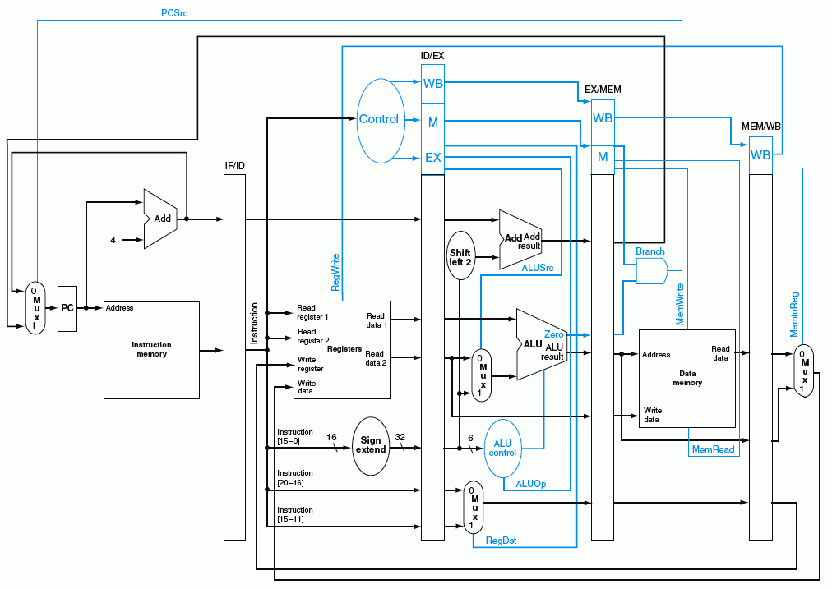
蓝色部分是控制信号

Slide 37
第一讲内容小结
指令的执行可以像洗衣服一样，用流水线方式进行
  均衡时指令吞吐率提高N倍，但不能缩短一条指令的执行时间
  流水段数以最复杂指令所需步骤数为准（有些指令的某些阶段为空操作），每个阶段的宽度以最复杂阶段所需时间为准（尽量调整使各阶段均衡）
以Load指令为准，分为五个阶段
  取指令段(IF)
    取指令、计算PC+4（IUnit：Instruction Memory、Adder）
  译码/读寄存器(ID/RF)段
    指令译码、读Rs和Rt（寄存器读口）
  执行(EXE)段
    计算转移目标地址、ALU运算（Extender、ALU、Adder）
  存储器(MEM)段
    读或写存储单元（Data Memory）
  写寄存器(Wr)段
    ALU结果或从DM读出数据写到寄存器（寄存器写口）
流水线控制器的实现
  IF和ID/RF段不需控制信号控制，只有EXE、MEM和Wr需要
  ID段生成所有控制信号，并随指令的数据同步向后续阶段流动
寄存器和存储器的竞争问题可利用时钟信号来解决
流水线冒险：结构冒险、控制冒险、数据冒险
（下一讲主要介绍解决流水线冒险的数据通路如何设计）

Slide 38
第二讲 流水线冒险处理
主 要 内 容
结构冒险及其处理方法
数据冒险及其处理方法
控制冒险及其处理方法

Slide 39
流水线冒险（hazard）
在指令流水线中，当遇到某些情况使得流水线无法正确执行后续指令，而引起流水线阻塞或停顿，这个现象称为流水线冒险。
根据引起冒险的原因不同，分为结构冒险、数据冒险和控制冒险三种。
结构冒险
现象：同一个部件同时被不同指令所用，即使用硬件资源时发生了冲突。
时钟周期
Load
Mem
Reg
ALU
Mem
Reg
指令序列
Instr 1
Mem
Reg
ALU
Mem
Reg
Instr 2
Mem
Reg
ALU
Mem
Reg
Instr 3
Mem
Reg
ALU
Mem
Reg
Instr 4
Mem
Reg
ALU
Mem
Reg

Slide 40
结构冒险的解决方法
为了避免结构冒险，规定流水线数据通路中功能部件的设置原则为：
每个部件安排在特定的阶段使用！ 如：ALU总在指令的第三阶段使用
将Instruction Memory (Im) 和 Data Memory (Dm)分开
将寄存器读口和写口独立开来
时钟周期
Load
Im
Reg
ALU
Dm
Reg
Instr 1
Im
Reg
ALU
Dm
Reg
指令序列
Instr 2
Im
Reg
ALU
Dm
Reg
Instr 3
Im
Reg
ALU
Dm
Reg
Instr 4
Im
Reg
ALU
Dm
Reg

Slide 41
数据冒险（ Data Hazard ）
现象：后面指令用到前面指令结果时，前面指令的结果还没产生。
时钟周期
例如：
IF
ID/RF
Ex
Mem
Wr
add r1,r2,r3
Im
Reg
ALU
Dm
Reg
指令序列
sub r4,r1,r3
Im
Reg
ALU
Dm
Reg
and r6,r1,r7
Im
Reg
ALU
Dm
Reg
or r8,r1,r9
Im
Reg
ALU
Dm
Reg
xor r10,r1,r11
Im
Reg
ALU
Dm
Reg
第1条指令的目的操作数是r1，它是后面几条指令的源操作数。
第1条指令要到Wr阶段才写入r1，但后面的指令sub和and在此之前就读r1，or指令在Wr同时读r1，显然会得出错误的结果。

Slide 42
数据冒险的解决方法
方法1：硬件阻塞（stall）
方法2：软件插入“NOP”指令
方法3：合理实现寄存器组的读/写操作
方法4：转发（Forwarding或Bypassing 旁路）技术
方法5：编译优化--调整指令顺序（不能解决所有数据冒险）

Slide 43
方法1: 在硬件上采取措施，使相关指令延迟执行
硬件上通过阻塞(stall)方式阻止后续指令执行，延迟到有新值以后！
这种做法称为流水线阻塞，也称为插入“气泡(Bubble)”
Time (clock cycles)
IF
ID/RF
EX
MEM
WB
add r1,r2,r3
Im
Reg
ALU
Dm
Reg
I
n
s
t
r.
O
r
d
e
r
stall
Im
bubble
bubble
bubble
bubble
stall
Im
bubble
bubble
bubble
bubble
stall
Im
bubble
bubble
bubble
bubble
sub r4,r1,r3
Im
Reg
Dm
Reg
ALU
and r6,r1,r7
Im
Reg
Dm
ALU
缺点：控制比较复杂，需要改数据通路；指令被延迟三个时钟执行。

Slide 44
方法 2: 软件上插入空操作指令
由编译器插入三条NOP指令，浪费三条指令的空间和时间，是最差的做法。
好处：数据通路简单，即无需改数据通路。
Time (clock cycles)
IF
ID/RF
EX
MEM
WB
add r1,r2,r3
Im
Reg
ALU
Dm
Reg
I
n
s
t
r.
O
r
d
e
r
nop
Im
Reg
ALU
Dm
Reg
nop
Im
Reg
ALU
Dm
Reg
nop
Im
Reg
ALU
Dm
Reg
sub r4,r1,r3
Im
Reg
Dm
Reg
ALU
and r6,r1,r7
Im
Reg
ALU
Dm
与方案1比，哪个更快？
一样，都是延迟三个时钟周期！

Slide 45
方法3: 同一周期内寄存器组先写后读
寄存器组的读口和写口是相互独立的部件！前半时钟周期写，后半时钟周期读
  若同一个时钟内前面指令写入的数据正好是后面指令所读数据，就不会发生数据冒险。
例如：
Time (clock cycles)
IF
ID/RF
EX
MEM
WB
add r1,r2,r3
Im
Reg
ALU
Dm
Reg
I
n
s
t
r.
O
r
d
e
r
sub r4,r1,r3
Im
Reg
ALU
Dm
Reg
and r6,r1,r7
Im
Reg
ALU
Dm
Reg
or r8,r1,r9
Im
Reg
ALU
Dm
Reg
xor r10,r1,r11
Im
Reg
ALU
Dm
Reg
例子中add指令与or指令的冲突解决了，但与sub和and指令没有解决。
只能解决部分数据冒险！

Slide 46
方法4: 利用DataPath中的中间数据：转发+阻塞
Time (clock cycles)
IF
ID/RF
EX
MEM
WB
add r1,r2,r3
Im
Reg
ALU
Dm
Reg
I
n
s
t
r.
O
r
d
e
r
sub r4,r1,r3
Im
Reg
ALU
Dm
Reg
and r6,r1,r7
Im
Reg
ALU
Dm
Reg
or r8,r1,r9
Im
Reg
ALU
Dm
Reg
xor r10,r1,r11
Im
Reg
ALU
Dm
Reg
仔细观察后发现：流水段寄存器中早已有需要的值r1！
在哪个流水段R中？
把数据从流水段寄存器中直接取到ALU的输入端,称为转发或旁路（Bypassing）
    若相关数据是上条指令从DM读出内容，能转发吗？
不能，因为它送入段寄存器前，后条指令要在ALU中用。
    因此，后条指令需被阻塞一个时钟 或 加NOP指令。
    这种数据冒险称为Load-use数据冒险

Slide 47
方法5：编译器进行指令顺序调整来解决数据冒险
实现“转发”和“阻塞” 要修改数据通路：
检测何时需要“转发”或 “阻塞”，并控制实现“转发”或“阻塞”。
如果硬件不支持转发和阻塞处理，或对于Load-use冒险，则编译器可调整指令顺序或插入NOP指令。
例如，以下源程序可生成两种不同的代码，优化的代码可避免Load-use阻塞
a = b + c;
d = e – f;
假定 a, b, c, d ,e, f 在内存
Load-use阻塞
Slow code:
lw $2, b
lw $3, c
add $1, $2, $3
sw $1, a
lw $5, e
lw $6, f
sub $4, $5, $6
sw $4, d
Fast code:
lw $2, b
lw $3, c
lw $5, e
add $1, $2, $3
lw $6, f
sw $1, a
sub $4, $5, $6
sw $4, d
Load-use阻塞
可用转发处理
调整后
可用转发处理
编译器的优化很重要！

Slide 48
控制冒险（ Control Hazard ）
现象：当遇到改变指令执行顺序的转移指令（调用、返回等）、异常和中断情况时，在形成转移目的地址之前，流水线中已取了后续指令并在执行，这时就需要清除流水线中的部分指令的执行。
Cycle 4
Cycle 5
Cycle 6
Cycle 7
Cycle 8
Cycle 9
Cycle 10
Cycle 11
Clk
12: Beq
(target is 1000)
Ifetch
Reg/Dec
Exec
Mem
Wr
16: R-type
Ifetch
Reg/Dec
Exec
Mem
Wr
20: R-type
Ifetch
Reg/Dec
Exec
Mem
Wr
例如,Beq指令转移地址为1000。
24: R-type
Ifetch
Reg/Dec
Exec
Mem
Wr
1000: Target of Br
Ifetch
Reg/Dec
Exec
Mem
Wr
Beq指令在第4周期取出，但要在Mem阶段才确定“是否转移”，即在第7周期目标地址才被送到PC输入端，第8周期才取出目标地址处的指令执行。
结果：在取目标指令之前，已有三条指令被取出，取错了三条指令！
发生转移时，要在流水线中清除Beq后面的三条指令，分别在Exec 、Reg/Dec、 Ifetch段中
延迟损失时间片C：发生转移时，给流水线带来的延迟损失
这里 C=3

Slide 49
控制冒险的解决方法
方法1：硬件上阻塞（stall）分支指令后三条指令的执行
  使后面三条指令清0或 其操作信号清0，即插入三个气泡。
方法2：软件上插入三条“NOP”指令
（以上两种方法的效率太低，需结合分支预测进行）
方法3：分支预测（Predict）
  简单（静态）预测：
    总是预测条件不满足(not taken)，即：继续执行分支指令的后续指令
    可加启发式规则：在特定情况下总是预测满足(taken)，其他情况总是预测不满足。如：循环顶部分支总是预测为不满足（循环底部分支总是预测为满足），则能达65%-85%的预测准确率。
  动态预测：
    根据程序执行的历史情况进行动态预测调整，能达90%的预测准确率。
方法4：延迟分支（Delayed branch）（通过编译程序优化指令顺序！）
  把分支指令前面与分支指令无关的指令调到分支指令后执行，也称延迟转移
对于异常或中断控制冒险的处理参见教材相关介绍

Slide 50
作业
P232 4, 6

